Slide 1
IT 140 Game Design
Alyssa Osborne

Slide 2
Storyboard: Description
The theme of the game will be a post-apocalyptic nuclear setting in which the player needs to find food, which is sparse due to the fall of society, to gain enough energy to defeat the radioactive monster and escape the nuclear testing facility they are stuck in. The rooms will include a starting room (START), a villain room (HAZARD), as well as the MED BAY, LAB, STORAGE, CENTRAL HUB, REACTOR, and VAULT. Each room aside from START and HAZARD will contain ITEMS. The items will be fruits, which the player will be traveling through the lab to collect. Fruits include an APPLE, ORANGE, BANANA, GRAPES, CHERRY, and PINEAPPLE.
Once the player has retrieved all the fruit, they now have enough energy to fight the radioactive monster and escape, therefore ending the game.

Slide 3
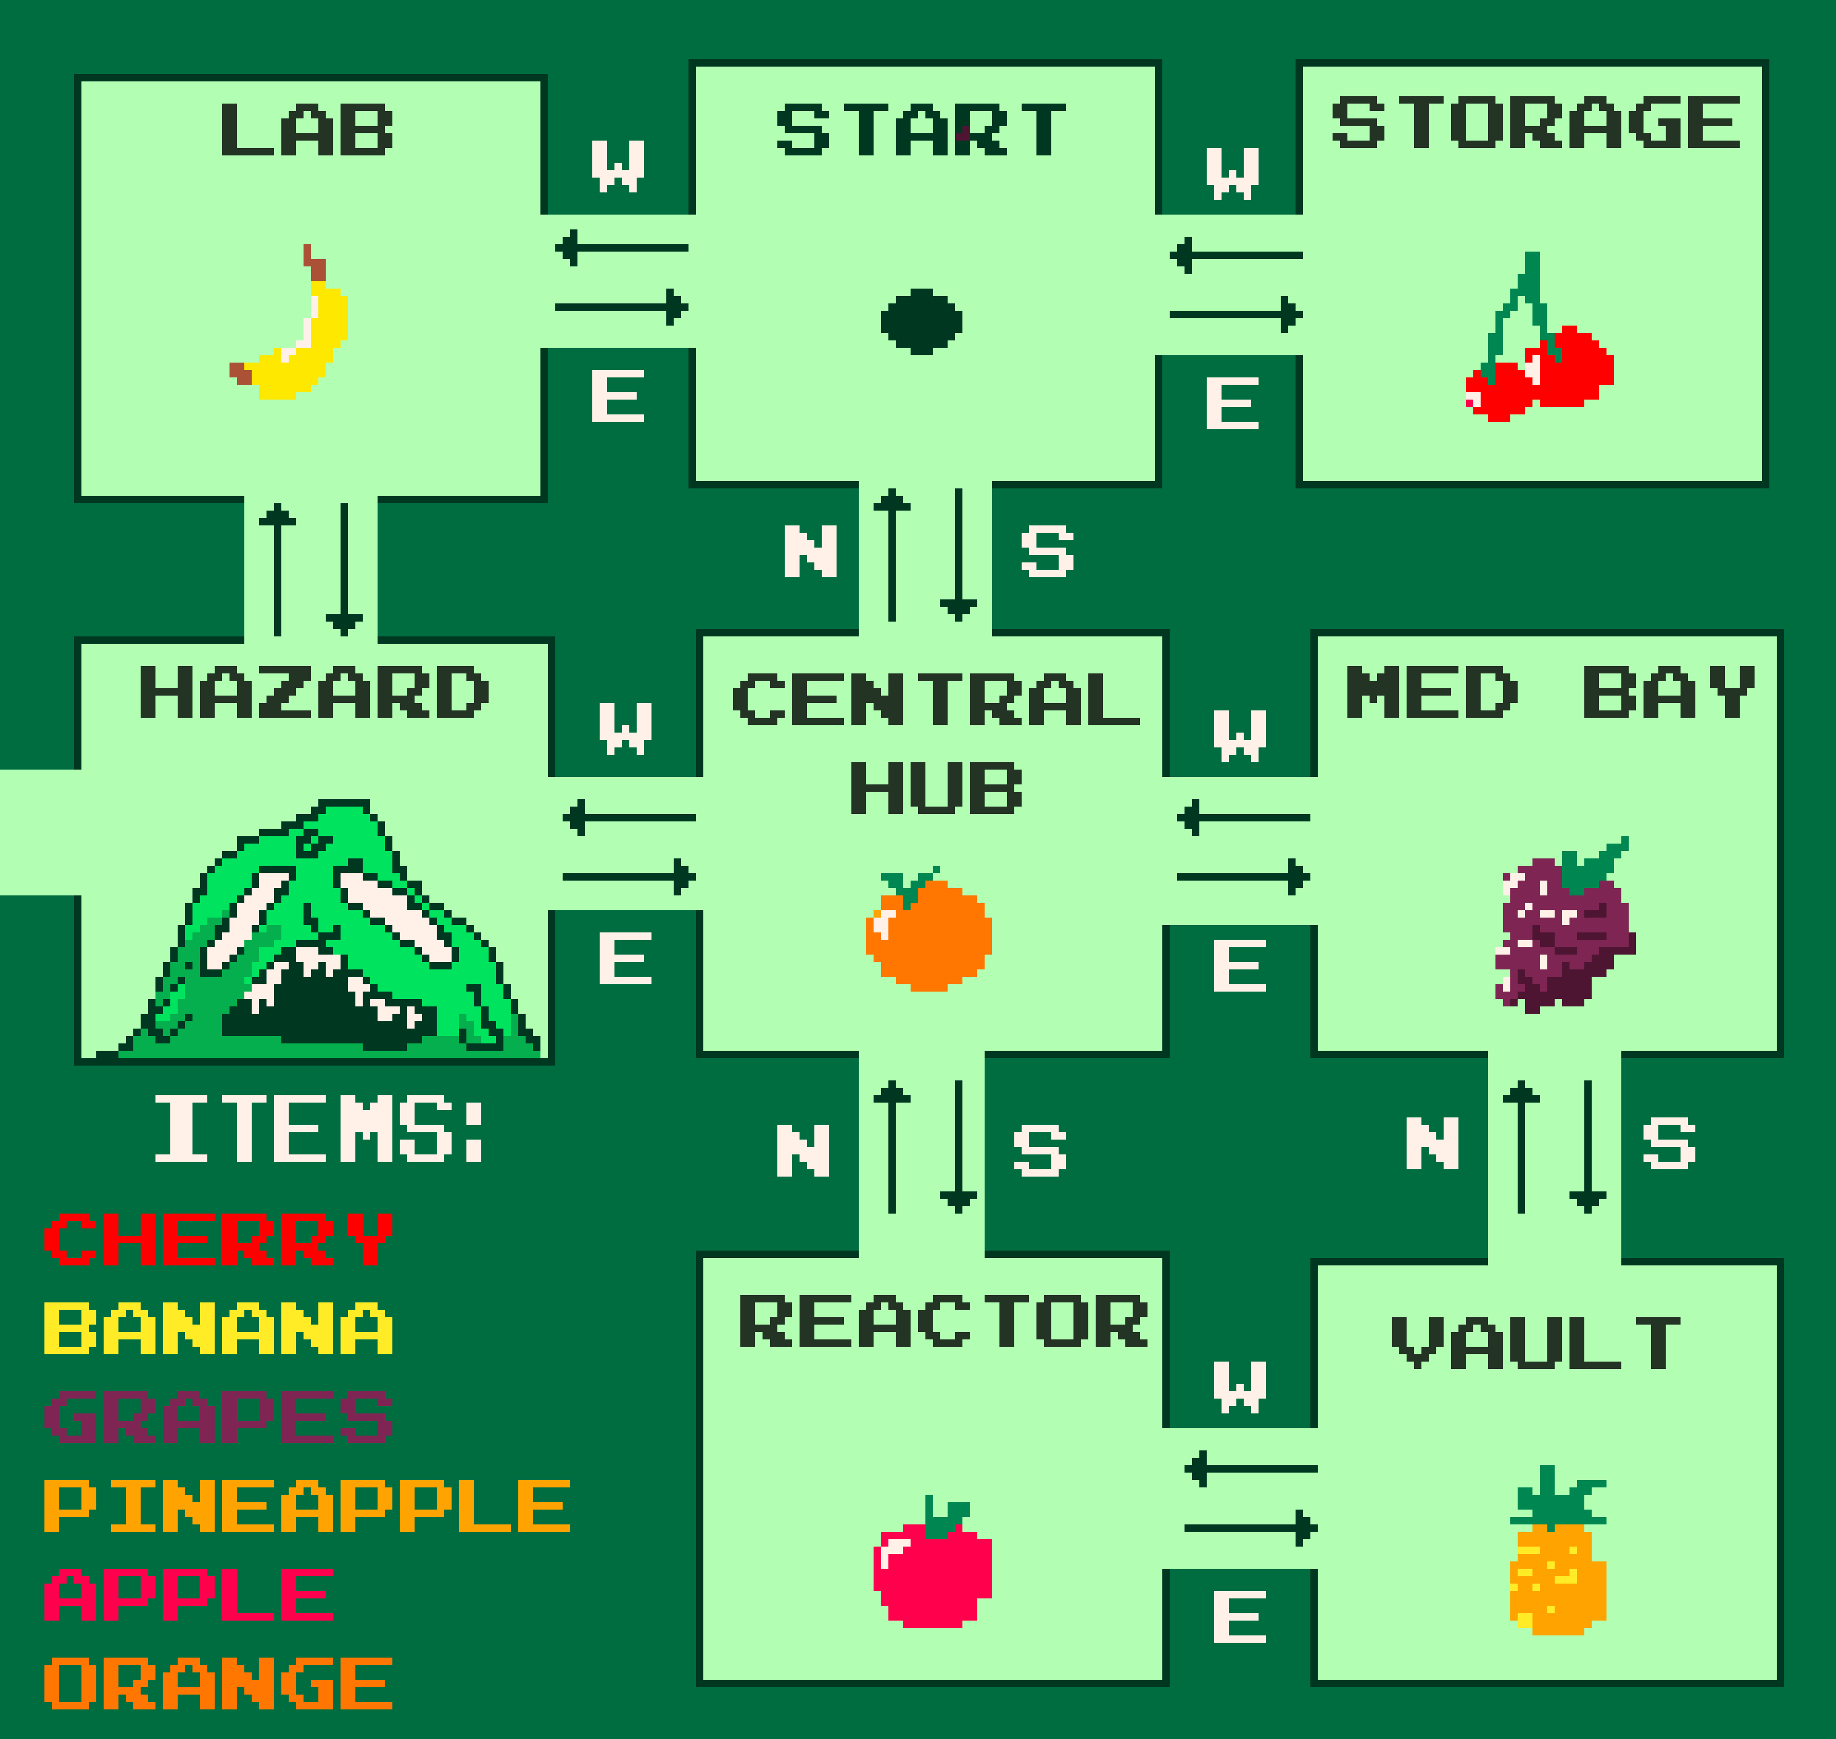
Storyboard: Map
8 ROOMS and 6 ITEMS to collect, the player begins at the START room and must avoid the HAZARD room to collect all ITEMS (fruits). Only once they have acquired the fruits can they enter the HAZARD room.

Slide 4
Pseudocode:
Move Between Rooms
START GAME
Set current_room = Start
Create empty inventory
WHILE game is running
Show current room
Show inventory
Ask player for command
(go North / South / East / West)
IF command is a direction
IF direction is valid
Move player to new room
ELSE
Display: “You can’t go that way!”
ELSE
Display: “Invalid command!”
CHECK GAME STATUS
IF player enters Villain room without all items
→ GAME OVER
IF inventory has all fruit items
→ YOU WIN
END LOOP
ROOMS:
START
HAZARD
LAB
MED BAY
CENTRAL HUB
STORAGE
VAULT
REACTOR

Slide 5
Pseudocode or Flowchart:
Get an Item
PLAYER INPUT
Ask for command
(get Cherry, get Banana, etc.)
IF command starts with “get”
IF item exists in current room
→ Add item to inventory
→ Remove item from room
→ Display: “Item retrieved!”
ELSE
→ Display: “Can’t get that item!”
ELSE
Display: “Invalid command!”
ITEMS:
BANANA
CHERRY
GRAPES
PINEAPPLE
APPLE
ORANGE

